Slide 1

CAR PARKING TOKEN SYSTEM
Car parking Token System Using Queue (ADT)
A car parking token system organizes customers so everyone is served in the order they arrive — avoiding confusion, reducing waiting-time disputes, and improving service efficiency.
The Queue Abstract Data Type (ADT) is the most suitable choice because it follows the First In, First Out (FIFO) principle — the customer who arrives first is served first.
Presented by
Saravana.H
192511397
Technical Presentation

Slide 2
QUEUE ADT
What is a Queue?
A Queue is a linear data structure that follows the FIFO (First In, First Out) principle.
1
Enqueue
Add a customer to the rear of the queue.
EXAMPLE
2
Dequeue
101
→
102
→
103
→
104
Remove the customer from the front of the queue.
3
Front (Peek)
FRONT
REAR
View the first customer.
Service Order
4
IsEmpty
101 → 102 → 103 → 104
Check whether the queue is empty.

Slide 3

JUSTIFICATION
Why Queue is Suitable
Ensures customers are served in arrival order
TIME COMPLEXITY
Prevents customers from skipping the line
Operation | Complexity
Enqueue | O(1)
Dequeue | O(1)
Front | O(1)
Simple and easy to implement
Provides fair and organized service
Suitable for cafeterias, banks, hospitals, and ticket counters
Conclusion: The Queue ADT guarantees fairness and efficient customer service using the FIFO principle.

Slide 4






BEYOND THE CAFETERIA
Real-World Applications
Cafeteria token systems
Bank counters
Hospital registration
Railway ticket booking
Printer scheduling
Call centers

Slide 5
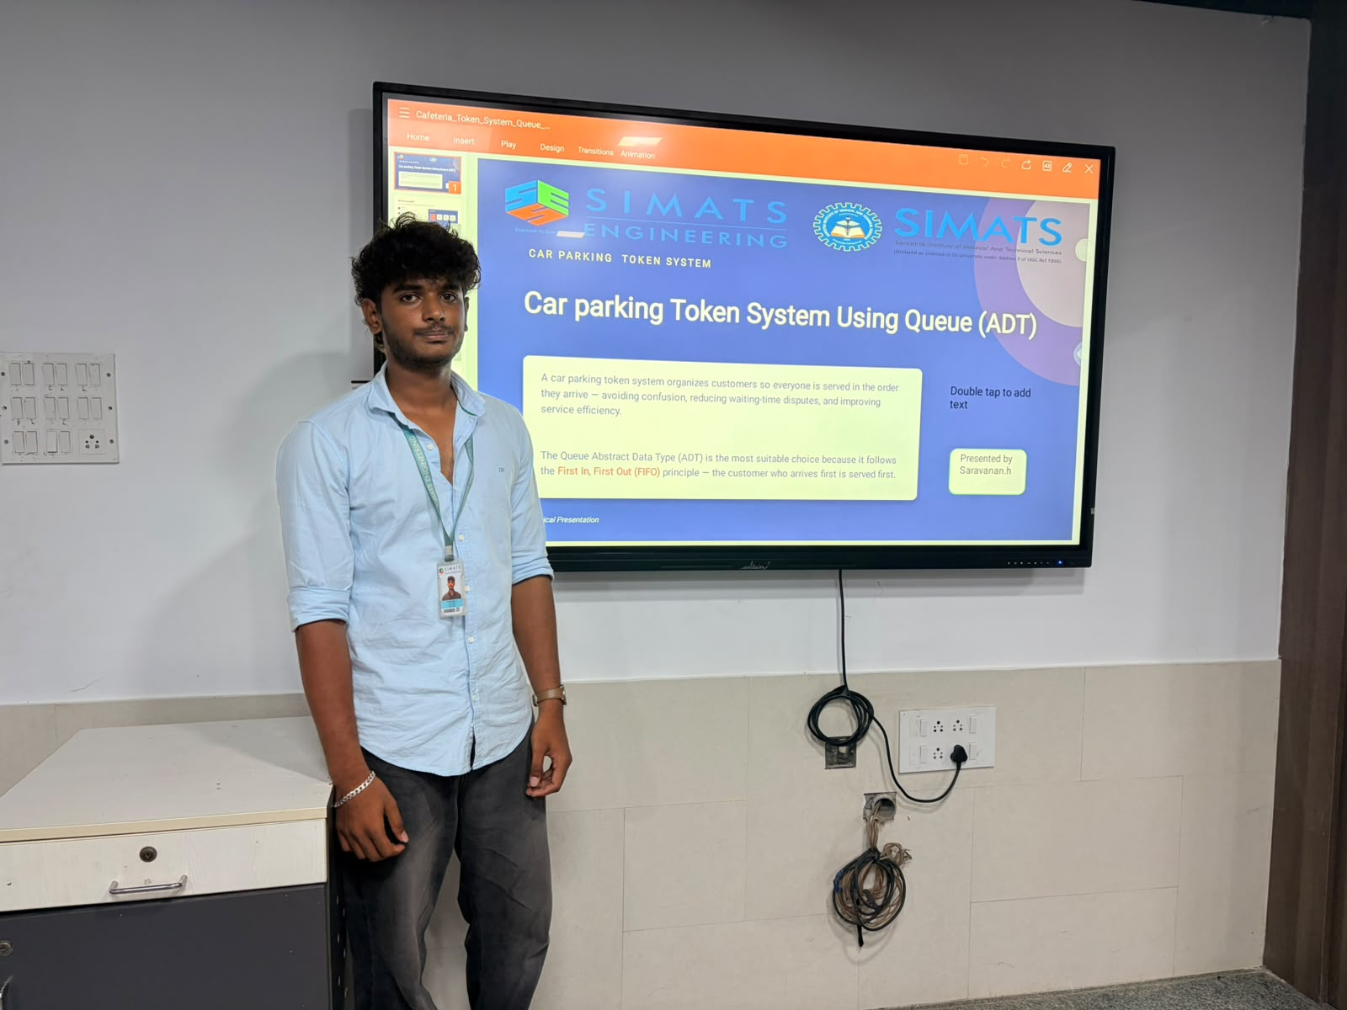
Thank You

